Slide 1


Machine Learning Fundamentals
11
PART III · MACHINE LEARNING CORE
CHAPTER 11 · WEEK 7
Data Science — From Foundations to Intelligent Systems
LECTURER
Dr. Mustafa Hameed
THE ISLAMIA UNIVERSITY OF BAHAWALPUR
Bahawalpur, Pakistan
Department of Information Technology · BSIT · Fall 2026
Notes:
Chapter 11: Machine Learning Fundamentals. Part 3 — Machine Learning Core. Week 7: ML fundamentals; regression (revision). Handout pages 70–75.

Slide 2

Where this chapter sits
THE COURSE
PART I
PART II
PART III
PART IV
PART V
PART VI
1
2
3
4
5
6
7
8
9
10
11
12
13
14
15
16
17
18
19
20
21
22
23
24
25
26
27
28
29
30
31
32
Machine Learning Fundamentals
BUILDS ON
USED LATER IN
Ch 4 The Mathematical Toolkit
Ch 12 Supervised Learning I: Regression
Ch 5 Describing Data: Centre, Spread and Shape
Ch 14 Model Evaluation and Selection
Ch 7 Acquisition, Wrangling and Cleaning
Ch 17 Neural Network Foundations
Data Science · Chapter 11 · Machine Learning Fundamentals
Handout p. 70 2
Notes:
Place the chapter. Before you start: Chapter 4 (vectors, loss, gradient descent), Chapter 7 (splitting and leakage) and Chapter 5. Revision note: this chapter, and the rest of Part III, revises Machine Learning Fall 2026 rather than teaching from zero — the mapping is set out below.

Slide 3

What you will be able to do
LEARNING OUTCOMES
By the end of this chapter you will be able to:
1
Distinguish supervised, unsupervised, semi-supervised and reinforcement learning, and match a problem to the right one.
2
Explain the purpose of the train/validation/test split and why the test set may be used only once.
3
Diagnose overfitting and underfitting from a learning curve.
4
Describe the bias–variance trade-off and how model complexity moves along it.
5
Justify why a baseline must precede any model.
Data Science · Chapter 11 · Machine Learning Fundamentals
Handout p. 70 3
Notes:
Read these out: they are the chapter's contract with the room. Each click adds one.

Slide 4

Vocabulary for this chapter
KEY TERMS
supervised / unsupervised / reinforcement learning
label
training, validation and test sets
generalisation
overfitting
underfitting
bias
variance
learning curve
hyperparameter
baseline
no free lunch
Each term is defined where it first matters — not here.
Data Science · Chapter 11 · Machine Learning Fundamentals
Handout p. 70 4
Notes:
Do not define these now; they arrive one at a time. This slide is for the students' notes. Terms: supervised / unsupervised / reinforcement learning; label; training, validation and test sets; generalisation; overfitting; underfitting; bias; variance; learning curve; hyperparameter; baseline; no free lunch.

Slide 5
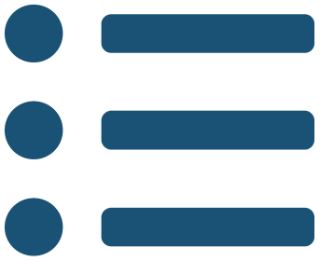
In this chapter
IN THIS CHAPTER
11.1
What Learning Means Here
p. 70 ›
11.2
The Four Paradigms
p. 71 ›
11.3
The Three-Way Split
p. 71 ›
11.4
Overfitting, Underfitting and the Learning Curve
p. 72 ›
11.5
Baselines and the No Free Lunch Theorem
p. 73 ›
Data Science · Chapter 11 · Machine Learning Fundamentals
Handout pp. 70–75 5
Notes:
The route through the chapter. Each row is a link: click it to jump to that section in the slide show.

Slide 6
What Learning Means Here
SECTION 1 OF 5
11.1
11.1 What Learning Means Here
11.2 The Four Paradigms
11.3 The Three-Way Split
11.4 Overfitting, Underfitting and the Learning Curve
11.5 Baselines and the No Free Lunch Theorem
Data Science · Chapter 11
Handout §11.1 6
Notes:
Pause. Name the question this section answers.

Slide 7

Part III Is Revision, Not First Exposure
CONCEPT
Every algorithm in Chapters 11–16 was already built from first principles in Machine Learning Fall 2026, taken as a prerequisite immediately before this course: Chapter 11 revises ML’s Chapters 1, 3 and 7; Chapter 12 revises ML’s Chapter 5; Chapter 13 surveys ML’s Chapters 6 and 9–12; Chapter 14 revises ML’s Chapter 8; Chapter 15’s ensembles revise ML’s Chapter 14 (feature engineering is new); Chapter 16’s clustering and PCA revise ML’s Chapters 15–16 (anomaly detection is new). These three weeks therefore move at revision pace: derivations are not repeated, and the emphasis shifts to applying each method correctly inside the data science lifecycle (Chapter 2) and reading its result through the Four Lenses. Part III finishes in Week 9 of the schedule, one week clear of the midterm, so no Machine-Learning-overlapping topic is left unfinished when that exam is set. If a term below is unfamiliar, the gap is in Machine Learning, not in this chapter — revisit it before continuing.
Data Science · Chapter 11 · Machine Learning Fundamentals
§11.1 · Handout p. 70 7
Notes:
Read the box aloud, then ask for an example from the room before moving on.

Slide 8

Machine Learning, Operationally
DEFINITION
A program learns from experience E with respect to task T and performance measure P if its performance on T, measured by P, improves with E. (Mitchell, 1997.) In practice: E is your training data, T is the prediction you framed in Chapter 2, and P is the metric of Chapter 14.
Data Science · Chapter 11 · Machine Learning Fundamentals
§11.1 · Handout p. 70 8
Notes:
Read the box aloud, then ask for an example from the room before moving on.

Slide 9
The Four Paradigms
SECTION 2 OF 5
11.2
11.1 What Learning Means Here
11.2 The Four Paradigms
11.3 The Three-Way Split
11.4 Overfitting, Underfitting and the Learning Curve
11.5 Baselines and the No Free Lunch Theorem
Data Science · Chapter 11
Handout §11.2 9
Notes:
Pause. Name the question this section answers.

Slide 10
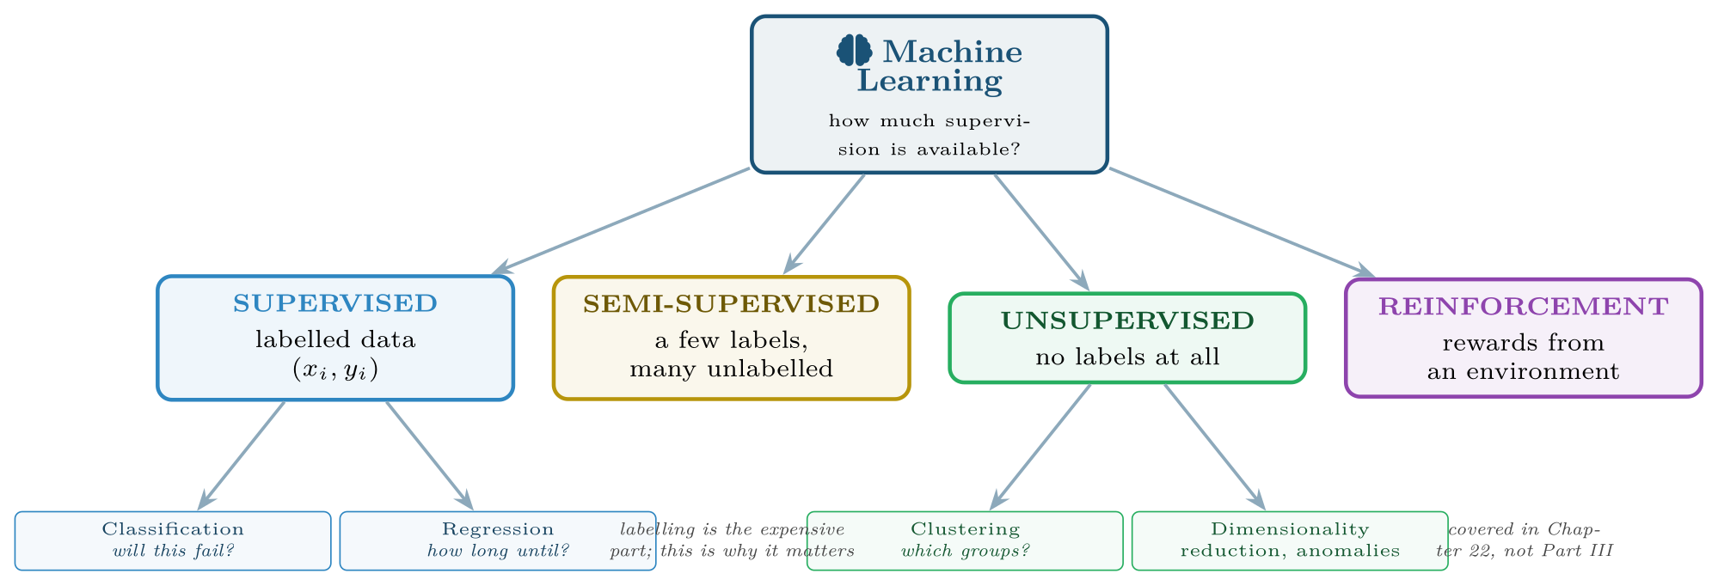
The learning paradigms, organised by how much supervision the data provides
FIGURE 11.1
Chapters 12–15 cover the supervised branch; Chapter 16 covers the unsupervised one.
Data Science · Chapter 11 · Machine Learning Fundamentals
§11.2 · Handout p. 71 10
Notes:
The crucial word is generalisation. Memorising the training data is trivial and worthless; the goal is performance on data the model has never seen. Everything in this chapter exists to protect that distinction.
Figure 11.1 (handout p. 71): The learning paradigms, organised by how much supervision the data provides. Chapters 12–15 cover the supervised branch; Chapter 16 covers the unsupervised one.

Slide 11
The Question That Picks Your Paradigm
CONCEPT
Do I have examples of the right answer? If yes, supervised. If no, but you want structure, unsupervised. If you have a few answers and lots of unlabelled data, semi-supervised. If the answer only emerges from acting and seeing what happens, reinforcement.
In practice the binding constraint is almost never the algorithm — it is whether anyone will pay to label 5,000 examples.
Data Science · Chapter 11 · Machine Learning Fundamentals
§11.2 · Handout p. 71 11
Notes:
Read the box aloud, then ask for an example from the room before moving on.

Slide 12
The Three-Way Split
SECTION 3 OF 5
11.3
11.1 What Learning Means Here
11.2 The Four Paradigms
11.3 The Three-Way Split
11.4 Overfitting, Underfitting and the Learning Curve
11.5 Baselines and the No Free Lunch Theorem
Data Science · Chapter 11
Handout §11.3 12
Notes:
Pause. Name the question this section answers.

Slide 13
Training, Validation and Test Sets
DEFINITION
Training set (typically 60–70%): the model learns its parameters here.
Validation set (15–20%): you compare models and tune hyperparameters here.
Test set (15–20%): used once, at the very end, to estimate real-world performance.
Data Science · Chapter 11 · Machine Learning Fundamentals
§11.3 · Handout p. 71 13
Notes:
Read the box aloud, then ask for an example from the room before moving on.

Slide 14
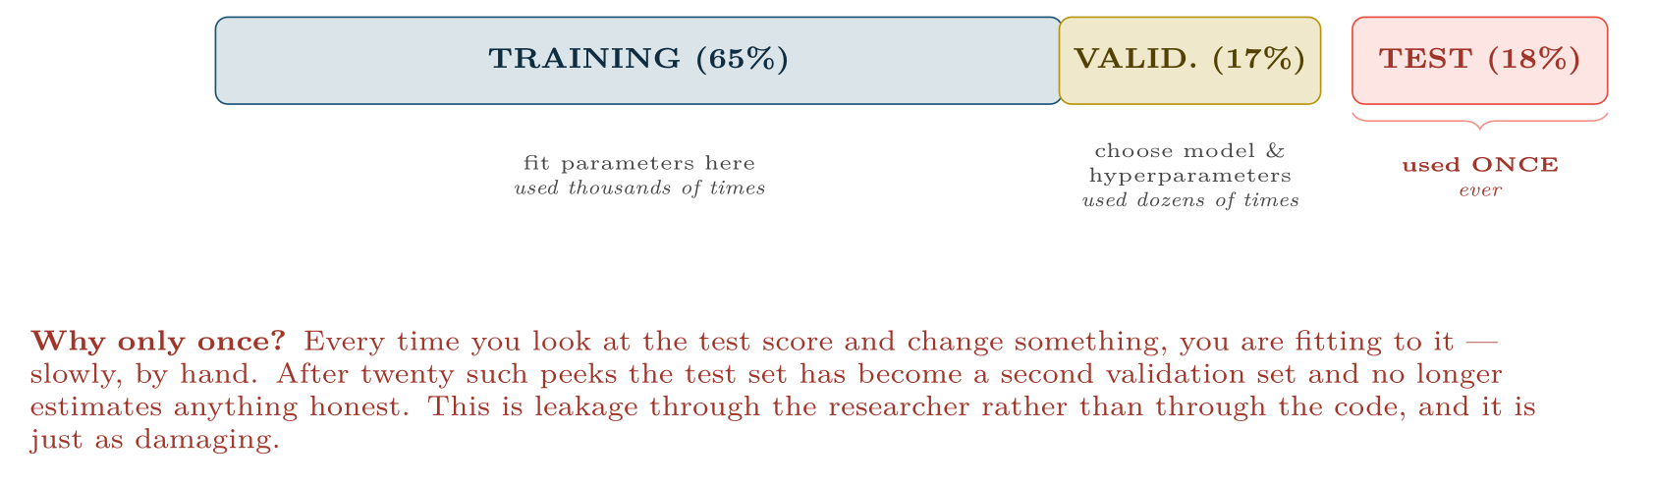
The three-way split and the discipline it demands
FIGURE 11.2
The validation set exists precisely so that the test set can stay untouched — without it, every tuning decision contaminates your final estimate.
Data Science · Chapter 11 · Machine Learning Fundamentals
§11.3 · Handout p. 71 14
Notes:
Figure 11.2 (handout p. 72): The three-way split and the discipline it demands. The validation set exists precisely so that the test set can stay untouched — without it, every tuning decision contaminates your final estimate.

Slide 15

Stratify, and Split by Entity
WATCH OUT
When classes are imbalanced, use a stratified split so each part keeps the same class proportions — otherwise a rare class may be absent from the test set entirely. And when rows are grouped (many readings per device, many sessions per user), split by device or user, not by row: the same entity appearing in both train and test is leakage (Chapter 7).
Data Science · Chapter 11 · Machine Learning Fundamentals
§11.3 · Handout p. 71 15
Notes:
Read the box aloud, then ask for an example from the room before moving on.

Slide 16
Overfitting, Underfitting and the Learning Curve
SECTION 4 OF 5
11.4
11.1 What Learning Means Here
11.2 The Four Paradigms
11.3 The Three-Way Split
11.4 Overfitting, Underfitting and the Learning Curve
11.5 Baselines and the No Free Lunch Theorem
Data Science · Chapter 11
Handout §11.4 16
Notes:
Pause. Name the question this section answers.

Slide 17
Overfitting and Underfitting
DEFINITION
Overfitting: the model has learned the noise as well as the signal. Training error is low, validation error is high.
Underfitting: the model is too simple to capture the signal. Both errors are high.
Data Science · Chapter 11 · Machine Learning Fundamentals
§11.4 · Handout p. 72 17
Notes:
Read the box aloud, then ask for an example from the room before moving on.

Slide 18
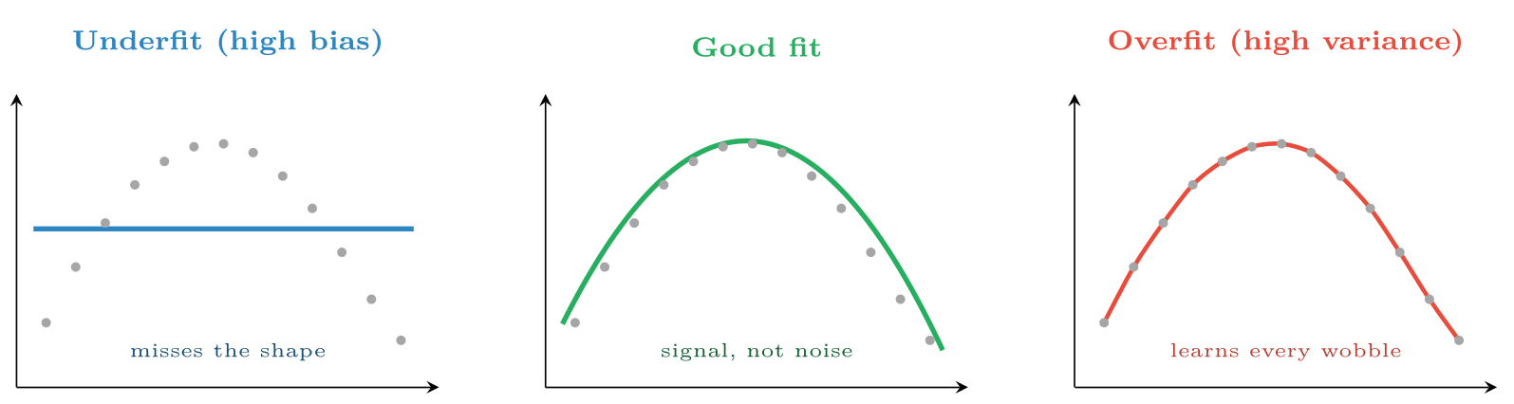
The same 13 points fitted three ways
FIGURE 11.3
The overfitted curve passes through every point and has zero training error — and would predict badly for any new observation.
Data Science · Chapter 11 · Machine Learning Fundamentals
§11.4 · Handout p. 72 18
Notes:
Figure 11.3 (handout p. 72): The same 13 points fitted three ways. The overfitted curve passes through every point and has zero training error — and would predict badly for any new observation.

Slide 19
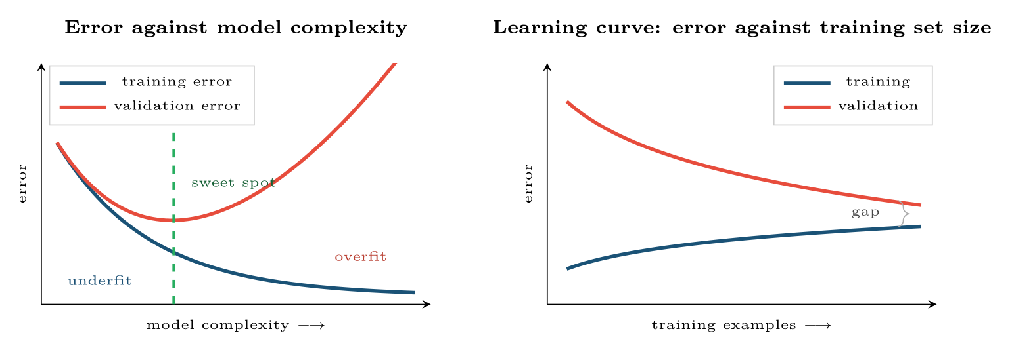
Two diagnostic plots you should produce for every model
FIGURE 11.4
Left: where a given complexity sits on the trade-off. Right: whether more data would help — a gap that is still closing says collect more; two curves that have converged high say the model is too simple.
Data Science · Chapter 11 · Machine Learning Fundamentals
§11.4 · Handout p. 72 19
Notes:
Figure 11.4 (handout p. 72): Two diagnostic plots you should produce for every model. Left: where a given complexity sits on the trade-off. Right: whether more data would help — a gap that is still closing says collect more; two curves that have converged high say the model is too simple.

Slide 20
The Bias–Variance Trade-off
DEFINITION
Bias is error from wrong assumptions — the model is too rigid to represent the truth. Variance is error from sensitivity to the particular training sample — fit it again on different data and you get a very different model. Total expected error decomposes as
Simple models have high bias and low variance; complex models the reverse.
Data Science · Chapter 11 · Machine Learning Fundamentals
§11.4 · Handout p. 72 20
Notes:
Read the box aloud, then ask for an example from the room before moving on.

Slide 21

Overfitting, Underfitting and the Learning Curve
AT A GLANCE
Symptom | Diagnosis | What to do
Train error high, validation error similarly high | Underfitting (high bias) | More complex model, better features, train longer, less regularisation
Train error low, validation error much higher | Overfitting (high variance) | More data, simpler model, more regularisation (Chapter 15), early stopping
Both low and close | Good fit | Stop. Verify once on the test set
Validation better than train | Suspect a bug | Usually a leak or a mis-specified split
Data Science · Chapter 11 · Machine Learning Fundamentals
§11.4 · Handout p. 72 21
Notes:
Do not read the table row by row: pick the row the room is most likely to get wrong and ask why.

Slide 22
Baselines and the No Free Lunch Theorem
SECTION 5 OF 5
11.5
11.1 What Learning Means Here
11.2 The Four Paradigms
11.3 The Three-Way Split
11.4 Overfitting, Underfitting and the Learning Curve
11.5 Baselines and the No Free Lunch Theorem
Data Science · Chapter 11
Handout §11.5 22
Notes:
Pause. Name the question this section answers.

Slide 23
Always Build the Baseline First
CONCEPT
Before any model, compute what a trivial rule achieves:
• Classification: always predict the majority class.
• Regression: always predict the mean.
• Time series: predict that tomorrow equals today.
• Domain rule: whatever the humans currently do.
A model that does not beat all four is not a result. This takes five minutes and has saved more student projects than any algorithm.
Data Science · Chapter 11 · Machine Learning Fundamentals
§11.5 · Handout p. 73 23
Notes:
Read the box aloud, then ask for an example from the room before moving on.

Slide 24
No Free Lunch
DEFINITION
Averaged over all possible problems, no algorithm outperforms any other. There is no universally best model — only models better suited to the structure of a particular problem. This is why Chapter 14 exists, and why “which algorithm is best?” is not a well-formed question.
Data Science · Chapter 11 · Machine Learning Fundamentals
§11.5 · Handout p. 73 24
Notes:
Read the box aloud, then ask for an example from the room before moving on.

Slide 25





Four lenses: Setting Up a Learning Problem
FOUR LENSES
LEARNING ANALYTICS
PROJECT MANAGEMENT
Paradigm: supervised classification — labels exist because past outcomes are recorded.
Paradigm: supervised, but with painfully few rows — a team may have 40 completed sprints, ever.
INTERNET OF THINGS
CYBERSECURITY
Paradigm: supervised for predictive maintenance if failure records exist; unsupervised anomaly detection if they do not — which is the common case, since well-maintained equipment rarely fails.
Paradigm: supervised where labelled attacks exist, unsupervised otherwise; in practice both, side by side.
Data Science · Chapter 11 · Machine Learning Fundamentals
Handout p. 75 25
Notes:
The same method, four domains. Each of the next four slides opens one lens in full.

Slide 26

Learning Analytics: Setting Up a Learning Problem
FOUR LENSES
LEARNING ANALYTICS
Project Management
Paradigm: supervised classification — labels exist because past outcomes are recorded. Split: by student, and stratified, since failures are the minority. Baseline: “flag anyone who missed two labs”, which is what staff already do; beat that or the model adds nothing. Overfitting risk: high, because n is small (one cohort) and p is large (hundreds of clickstream features).
Internet of Things
Cybersecurity
Data Science · Chapter 11 · Machine Learning Fundamentals
Handout p. 75 26
Notes:
Learning Analytics. Paradigm: supervised classification — labels exist because past outcomes are recorded. Split: by student, and stratified, since failures are the minority. Baseline: “flag anyone who missed two labs”, which is what staff already do; beat that or the model adds nothing. Overfitting risk: high, because n is small (one cohort) and p is large (hundreds of clickstream features).

Slide 27

Project Management: Setting Up a Learning Problem
FOUR LENSES
PROJECT MANAGEMENT
Learning Analytics
Paradigm: supervised, but with painfully few rows — a team may have 40 completed sprints, ever. Split: chronological, never random: predicting March from April is meaningless. Baseline: last sprint’s velocity. Overfitting risk: severe. With n=40, prefer a two-feature model you can explain over a tuned gradient-boosting machine you cannot.
Internet of Things
Cybersecurity
Data Science · Chapter 11 · Machine Learning Fundamentals
Handout p. 75 27
Notes:
Project Management. Paradigm: supervised, but with painfully few rows — a team may have 40 completed sprints, ever. Split: chronological, never random: predicting March from April is meaningless. Baseline: last sprint’s velocity. Overfitting risk: severe. With n=40, prefer a two-feature model you can explain over a tuned gradient-boosting machine you cannot.

Slide 28

Internet of Things: Setting Up a Learning Problem
FOUR LENSES
INTERNET OF THINGS
Learning Analytics
Paradigm: supervised for predictive maintenance if failure records exist; unsupervised anomaly detection if they do not — which is the common case, since well-maintained equipment rarely fails. Split: by device and chronologically. Baseline: fixed-interval servicing. Data: abundant rows but very few positive labels, so the effective sample size is the failure count, not the row count.
Project Management
Cybersecurity
Data Science · Chapter 11 · Machine Learning Fundamentals
Handout p. 75 28
Notes:
Internet of Things. Paradigm: supervised for predictive maintenance if failure records exist; unsupervised anomaly detection if they do not — which is the common case, since well-maintained equipment rarely fails. Split: by device and chronologically. Baseline: fixed-interval servicing. Data: abundant rows but very few positive labels, so the effective sample size is the failure count, not the row count.

Slide 29

Cybersecurity: Setting Up a Learning Problem
FOUR LENSES
CYBERSECURITY
Learning Analytics
Paradigm: supervised where labelled attacks exist, unsupervised otherwise; in practice both, side by side. Split: strictly chronological — training on 2026 attacks to detect 2025 ones proves nothing. Baseline: the existing signature rules. Special difficulty: the data distribution is actively changed by an adversary, so the i.i.d. assumption underlying all of Part III is false here. Chapter 26 confronts this directly.
Project Management
Internet of Things
Data Science · Chapter 11 · Machine Learning Fundamentals
Handout p. 75 29
Notes:
Cybersecurity. Paradigm: supervised where labelled attacks exist, unsupervised otherwise; in practice both, side by side. Split: strictly chronological — training on 2026 attacks to detect 2025 ones proves nothing. Baseline: the existing signature rules. Special difficulty: the data distribution is actively changed by an adversary, so the i.i.d. assumption underlying all of Part III is false here. Chapter 26 confronts this directly.

Slide 30

Try it yourself: Split, Baseline, Diagnose
TRY IT YOURSELF
THIS WEEK'S LAB
WHAT YOU WILL RUN
Week 7: Split, baseline, diagnose; fit & regularise
1 listing, 29 lines of Python
Data Science · Chapter 11 · Machine Learning Fundamentals
§11.5 · Handout p. 73 30
Notes:
Say what the room will have at the end of the lab, then let them start. Circulate rather than lecture.

Slide 31
Split, Baseline, Diagnose
LAB · STEP 1 OF 2
Set-up
Python
1
2
3
4
5
6
7
8
9
10
11
12
13
14
15
import numpy as np
from sklearn.model_selection import train_test_split, learning_curve
from sklearn.dummy import DummyClassifier
from sklearn.tree import DecisionTreeClassifier
import matplotlib.pyplot as plt
X, y = ... # your features and labels
# 1. Stratified split -- keeps the rare class present everywhere.
X_tr, X_te, y_tr, y_te = train_test_split(
X, y, test_size=0.2, stratify=y, random_state=42)
# 2. BASELINE FIRST. Never skip this.
base = DummyClassifier(strategy="most_frequent").fit(X_tr, y_tr)
print(f"baseline accuracy: {base.score(X_tr, y_tr):.3f}")
Data Science · Chapter 11 · Machine Learning Fundamentals
§11.5 · Handout p. 73 31
Notes:
Step 1: Set-up. Read the code aloud; ask what each line would print before running it.

Slide 32
Split, Baseline, Diagnose
LAB · STEP 2 OF 2
Python
16
17
18
19
20
21
22
23
24
25
26
27
28
# 3. Overfitting demonstration: an unconstrained tree memorises.
deep = DecisionTreeClassifier().fit(X_tr, y_tr)
print(f"deep tree train {deep.score(X_tr, y_tr):.3f}") # ~1.000 -- memorised
shallow = DecisionTreeClassifier(max_depth=3).fit(X_tr, y_tr)
print(f"depth-3 train {shallow.score(X_tr, y_tr):.3f}")
# 4. Learning curve: would more data help?
sizes, tr_sc, va_sc = learning_curve(
DecisionTreeClassifier(max_depth=5), X_tr, y_tr, cv=5,
train_sizes=np.linspace(0.1, 1.0, 8))
plt.plot(sizes, tr_sc.mean(1), label="training")
plt.plot(sizes, va_sc.mean(1), label="validation")
plt.xlabel("training examples"); plt.ylabel("accuracy"); plt.legend(); plt.show()
Data Science · Chapter 11 · Machine Learning Fundamentals
§11.5 · Handout p. 73 32
Notes:
Read the code aloud; ask what each line would print before running it.

Slide 33
What the lab shows
TRY IT YOURSELF
Read the curve: still converging ⇒ collect more data. Converged with a gap ⇒ regularise. Converged with no gap but low ⇒ the model is too simple or the features are inadequate.
Data Science · Chapter 11 · Machine Learning Fundamentals
§11.5 · Handout p. 73 33
Notes:
Read the box aloud, then ask for an example from the room before moving on.

Slide 34

A model scores 0.99 on training and 0.61 on validation. Name the problem and give two remedies.
CHECKPOINT 1 OF 3
Discuss with the person next to you, then advance.
Data Science · Chapter 11 · Machine Learning Fundamentals
Handout p. 75 · answers in Appendix D 34
Notes:
Ask the room. Do not advance until someone commits to an answer.

Slide 35

A model scores 0.99 on training and 0.61 on validation. Name the problem and give two remedies.
CHECKPOINT 1 OF 3 · ANSWER
Overfitting (high variance). Remedies: simplify the model or regularise; obtain more training data; use early stopping; reduce the feature count.
Data Science · Chapter 11 · Machine Learning Fundamentals
Handout p. 75 · answers in Appendix D 35
Notes:
Answer (Appendix D): Overfitting (high variance). Remedies: simplify the model or regularise; obtain more training data; use early stopping; reduce the feature count.

Slide 36
Why can the test set be used only once, and what exactly goes wrong on the twentieth use?
CHECKPOINT 2 OF 3
Discuss with the person next to you, then advance.
Data Science · Chapter 11 · Machine Learning Fundamentals
Handout p. 75 · answers in Appendix D 36
Notes:
Ask the room. Do not advance until someone commits to an answer.

Slide 37
Why can the test set be used only once, and what exactly goes wrong on the twentieth use?
CHECKPOINT 2 OF 3 · ANSWER
Because every look at the test score followed by a change is a form of fitting to it. After twenty such iterations the test set has effectively become a validation set, and its score no longer estimates performance on genuinely unseen data.
Data Science · Chapter 11 · Machine Learning Fundamentals
Handout p. 75 · answers in Appendix D 37
Notes:
Answer (Appendix D): Because every look at the test score followed by a change is a form of fitting to it. After twenty such iterations the test set has effectively become a validation set, and its score no longer estimates performance on genuinely unseen data.

Slide 38
You have 400 sensor readings from each of 10 machines. Should you split by row or by machine? Justify.
CHECKPOINT 3 OF 3
Discuss with the person next to you, then advance.
Data Science · Chapter 11 · Machine Learning Fundamentals
Handout p. 75 · answers in Appendix D 38
Notes:
Ask the room. Do not advance until someone commits to an answer.

Slide 39
You have 400 sensor readings from each of 10 machines. Should you split by row or by machine? Justify.
CHECKPOINT 3 OF 3 · ANSWER
By machine. Readings from the same machine are highly correlated, so splitting by row would put near-identical rows in both train and test — leakage that inflates the score.
Data Science · Chapter 11 · Machine Learning Fundamentals
Handout p. 75 · answers in Appendix D 39
Notes:
Answer (Appendix D): By machine. Readings from the same machine are highly correlated, so splitting by row would put near-identical rows in both train and test — leakage that inflates the score.

Slide 40

What to take away
CHAPTER SUMMARY
1
Learning means generalising, not memorising. Everything here protects that distinction.
2
Choose the paradigm by asking whether examples of the right answer exist; labelling cost usually decides the project.
3
Train fits parameters, validation chooses models, test is used once. Stratify for imbalance and split by entity when rows are grouped.
4
Overfitting is low train / high validation error; underfitting is both high. Learning curves tell you which, and whether more data would help.
5
Bias–variance: simple models are rigid and stable, complex ones are flexible and jumpy. The best model is at the balance point, not at either end.
6
Build the baseline before the model. No free lunch means there is no universally best algorithm.
Data Science · Chapter 11 · Machine Learning Fundamentals
Handout p. 75 40
Notes:
Ask the room to say each takeaway before you reveal it.

Slide 41

Quick check 1 of 2
REVIEW · MULTIPLE CHOICE
High training accuracy with much lower validation accuracy indicates:
A
underfitting
B
overfitting
C
high bias
D
leakage only
Data Science · Chapter 11 · Machine Learning Fundamentals
Handout p. 75 41
Notes:
Take a show of hands for each option before discussing. (The handout does not print MCQ answers.)

Slide 42
Quick check 2 of 2
REVIEW · MULTIPLE CHOICE
A simple, rigid model typically has:
A
high bias, low variance
B
low bias, high variance
C
both high
D
both low
Data Science · Chapter 11 · Machine Learning Fundamentals
Handout p. 75 42
Notes:
Take a show of hands for each option before discussing. (The handout does not print MCQ answers.)

Slide 43
For your notebook
REVIEW QUESTIONS
SHORT
Explain the role of the validation set and why it is needed given that a test set already exists.
SHORT
State two sensible baselines for a regression problem and one for a time series.
SHORT
What does a learning curve whose two lines have converged at a high error tell you? What would you do next?
APPLIED
You have 40 sprints of project data and 60 candidate features. Explain the specific overfitting danger, and describe the model and validation strategy you would choose instead of a complex learner.
APPLIED
A colleague reports 99.4% accuracy detecting network intrusions where 0.6% of traffic is malicious. Explain why this number is uninformative, name the baseline it must be compared against, and state what you would ask to see instead.
Data Science · Chapter 11 · Machine Learning Fundamentals
Handout p. 75 43
Notes:
Set these for independent study. Model answers are not printed in the handout.

Slide 44
End of Chapter 11
11
NEXT
READ
Chapter 12 — Supervised Learning I: Regression
Handout Chapter 11, pages 70–75
THIS WEEK'S LAB
ASSESSMENT
Split, baseline, diagnose; fit & regularise
Assignment 1 due
Data Science · Chapter 11 · Machine Learning Fundamentals
44
Notes:
Close. NEXT: Chapter 12 — Supervised Learning I: Regression. READ: Handout Chapter 11, pages 70–75. THIS WEEK'S LAB: Split, baseline, diagnose; fit & regularise. ASSESSMENT: Assignment 1 due.

